Slide 1
MICROPROCESSORS

Slide 2
Introduction:
The microprocessor is the heart of any normal computer

Slide 3
Microprocessor History
•
A microprocessor -- also known as a CPU or central processing unit
.It is a complete computation engine that is fabricated on a single chip .
•
Intel gave the term ‘MICROPROCESSOR’ and in 1971 released the first 4-bit microprocessor as the 4004 having 2300 transistors, 640 bytes of memory addressing capacity and a 108 kHz clock speed.
•
The 4004 was not very powerful -- all it could do was add and subtract, and it could only do that 4 bits at a time .The 4004 powered one of the first portable electronic calculators.

Slide 4
Just 25 years since the invention of the 4004 ,we have processors that are designed with 15 million transistors, that can address 1 TB ( 1 × 10^12 ) of memory, and can operate at 400 MHz to 1.5 GHz frequency.
The Intel 4004 was quickly replaced by the 8-bit microprocessor (Intel 8008). In the mid 1970’s,the Intel 8080 was widely used in control applications & small computers also were designed using 8080 as CPU-also known as ‘Microcomputers’.
Most microcomputers are now built with 32 & 64-bit microprocessor.
The 8-bit microprocessors are being used as programmable logic devices in control applications & more powerful µ-processors are being used for mathematical computing & in data processing.

Slide 5
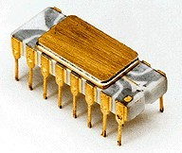
Intel 4004
The Intel 4004 was a 4-bit central processing unit (CPU) released by Intel Corporation in 1971.
It was the first complete CPU on one chip, and also the first commercially available microprocessor.

Slide 6
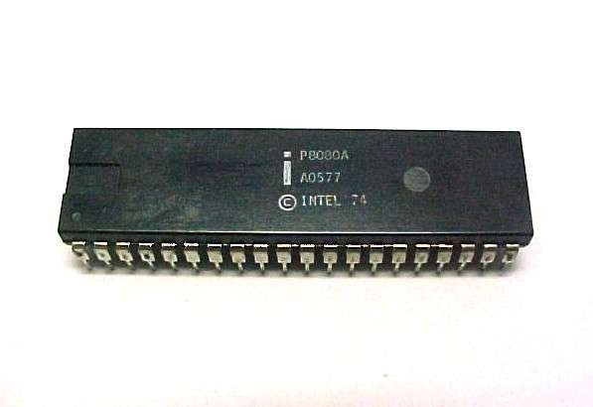
Intel 8080
The first microprocessor to make it into a home computer
Introduced in 1974 ,it was a complete 8-bit computer on one chip.
It was an extended and enhanced variant of the earlier 8008 design.
The initial specified clock freqency limit was 2 MHz
. The 8080 has sometimes been labeled "the first truly usable microprocessor",
•
•
•

Slide 7
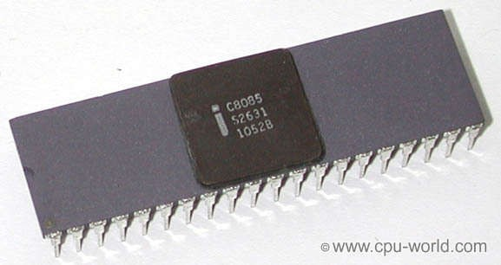
Intel 8085
The Intel 8085 is an 8-bit microprocessor introduced by Intel in 1977.
It was binary-compatible with the more-famous Intel 8080
The 8085 had a long life as a controller. The processor has seven 8-bit registers named A, B, C, D, E, H, and L, where A is the 8-bit accumulator and the other six can be used as independent byte- registers or as three 16-bit register pairs, BC, DE, and HL.
n

Slide 8
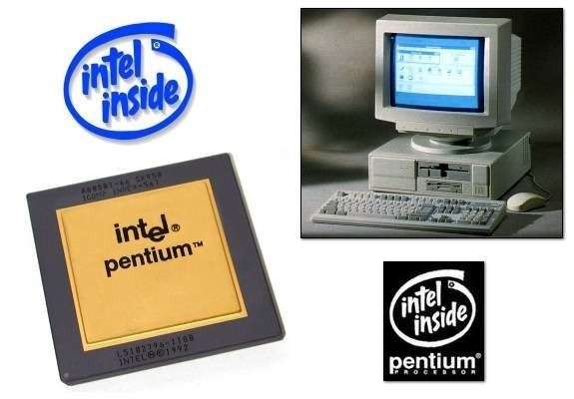
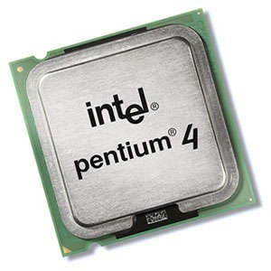
Pentium
Pentium is a registered trademark that is included in the brand names of many of Intel's x86-compatible microprocessors, The name was derived from the Greek pente (πέντε), meaning 'five‘.
Intel's fifth-generation P5, was first released underPentium the Pentium brand on March 22, 1993.
The Pentium 4 brand refers to Intel's line of single-core desktop and laptop CPUs introduced on November 20, 2000.
32-bit x86 instruction set of the Pentium 4 microprocessors was extended by the 64-bit x86-64 set & were clocked from from 1.3 GHz to 2 GHz .
•
•
•

Slide 9

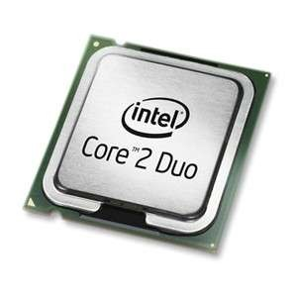
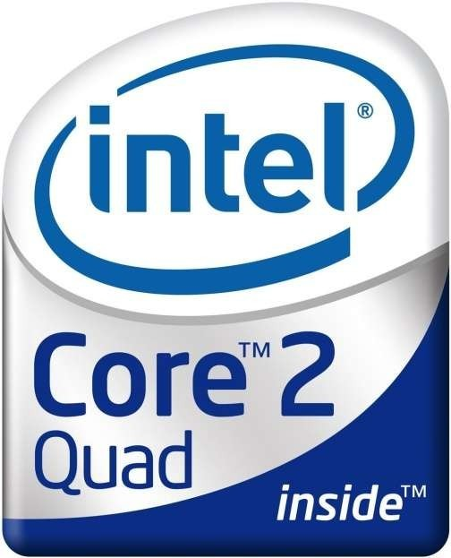
Latest µ-processors by Intel
2007, Intel released the desktop Pentium Dual-Core branded processors.
Core 2 is a brand encompassing a range of Intel's consumer 64-bit x86-64 single-, dual-, and quad-core microprocessors .

Slide 10
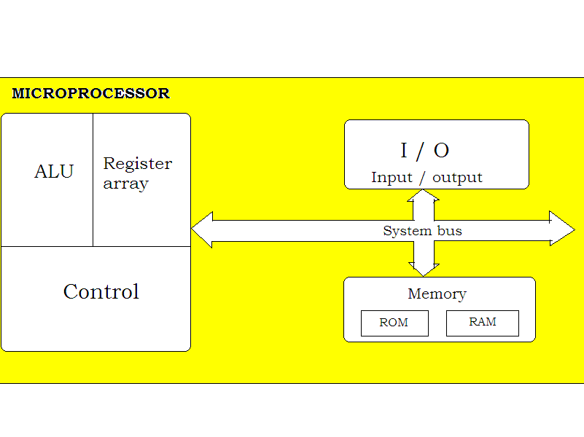
MICROPROCESSOR Based
System with Bus Architecture

Slide 11
How Does the µ-processor work?
The microprocessor works according to the pattern:
- READ
- FETCH
- DECODE
- EXECUTE
The instructions are stored sequentially in the memory. then µ-processor fetches the data/instruction from its memory sheet, decodes it, and executes that instruction. -

Slide 12
Contd..
This processing continued untill the instruction to STOP.
µ-processor uses the system bus to fetch the binary instructions and data from the memory.
It uses registers from the register section to store data temporarily, and it performs the computing function in the ALU section.
Finally it sends out the result in binary, using the same bus-lines to output ports.

Slide 13
Thank you

